Slide 1

El dragón chino es un animal mitológico y legendario de China y de otras culturas asiáticas que dispone de partes de nueve animales: ojos de langosta, cuernos de ciervo, morro de camello, nariz de perro, bigotes de bagre, melena de león, cola de serpiente, escamas de pez y garras de águila.

Slide 2

DRAGON FRAMEWORK
1 CODE
Many Platforms

Slide 3

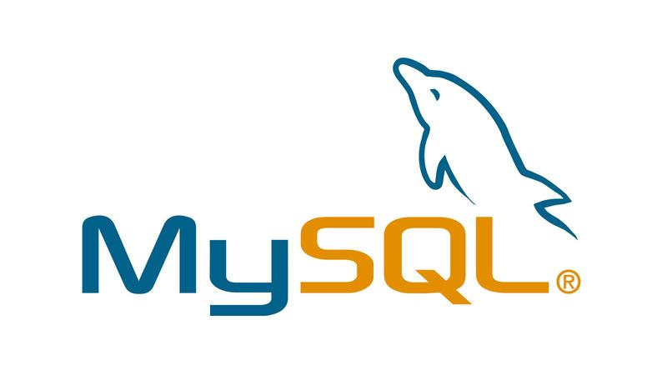
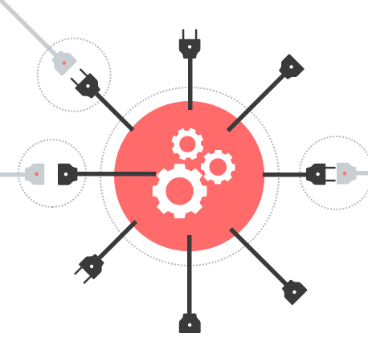




1
REST API

Slide 4







Same Code With Connect API

Slide 5


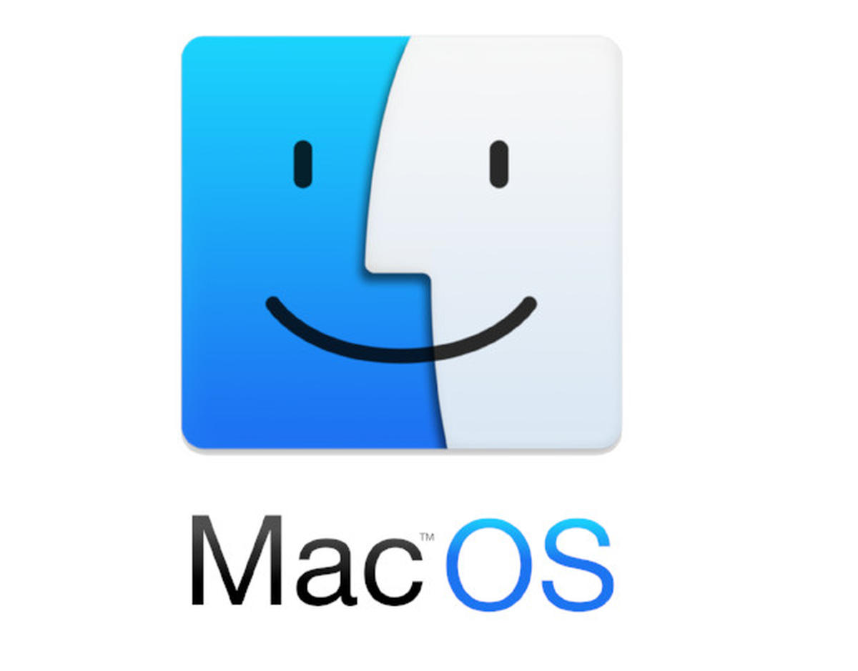
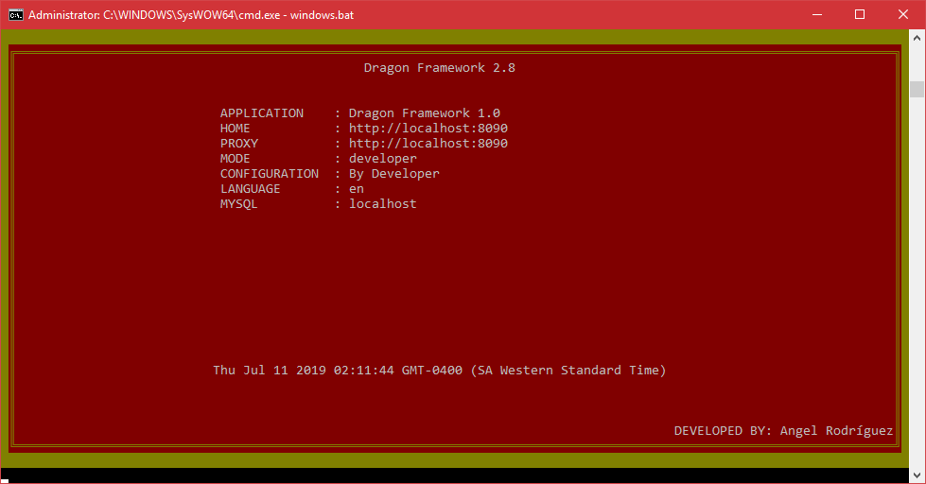


Slide 6
Server.
Create ENDPOINT JS Methods
CREATE Globalization Object
Create Dynamic Routes
Create Dynamic API
Create Simple Dynamic CRUD
Connect To Databases
Create DB REST API

Slide 7
Endpoint's to JS
END POINT CONFIG
Server Functions
Dynamic API Middleware
JavaScript Methods

Slide 8
Database to JS
Database
Server Functions
Dynamic API for Tables, Views, Functions y Procedures
JavaScript Methods

Slide 9
UI Flow
CONTROLLERS
CRUD CONFIG
VIEWS

Slide 10
Characteristics
Save behavior in local storage
Modules for developers and testers
Multi Language
Currency
Moment
Easy Components
Json Web Token
Code Generator based on database/API
Responsive
Environments And App Modes

Slide 11


Modules
Config
Dynamic Authentication
UI Permissions Groups
Dynamic Theme
Powerful CRUD’s
Azure AI

Slide 12
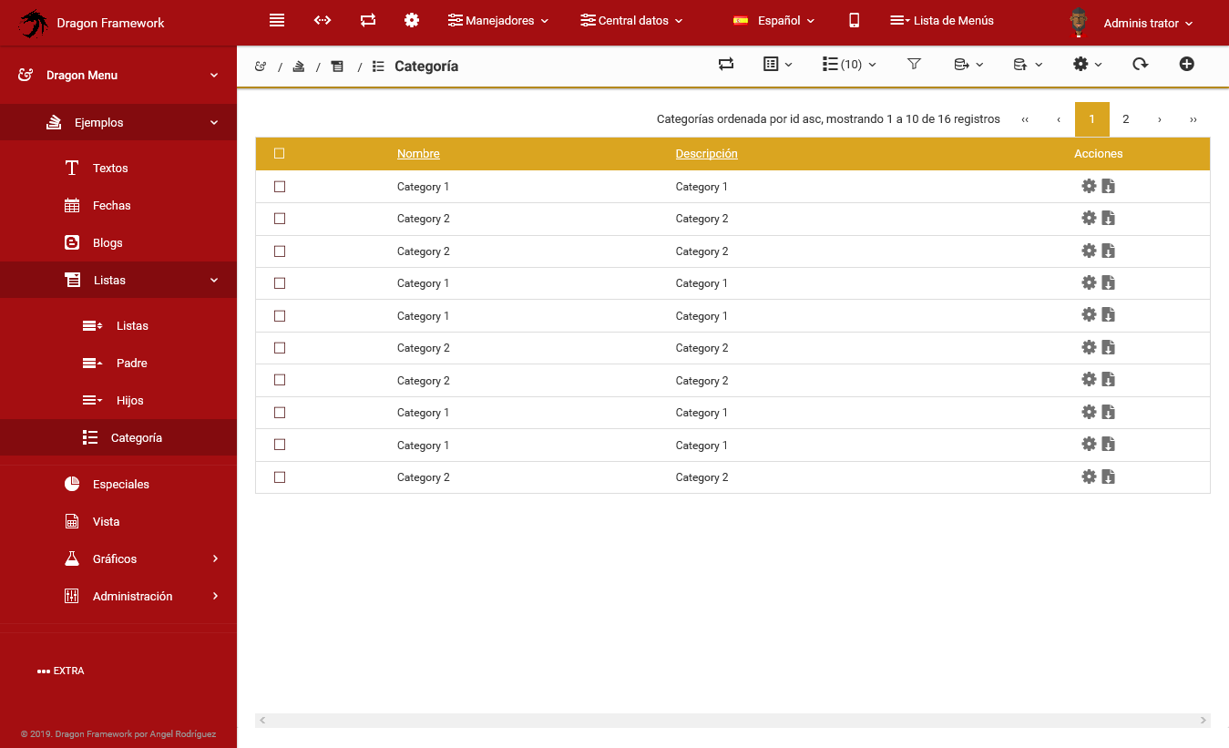

Slide 13
Modules to develop
Bootstrap Data Wizard
Inline Forms
Workflow Module
Sockets Push Module
Chat Online
Wizard APP

Slide 14
Thank You

